Slide 1



Dissemination & Demonstration
of
Eco-friendly Gas fired Kiln
for Qualitative Cost-effective Production of Pottery Products
Name of Implementing Agency
Shri Govind Gramin Wa Shahari Vikas Sanstha, Wardha
Project Coordinator-A.K.Gupta Project Coordinator-Ex -Scientist, CSIR - CGCRI Khurja Center

Slide 2
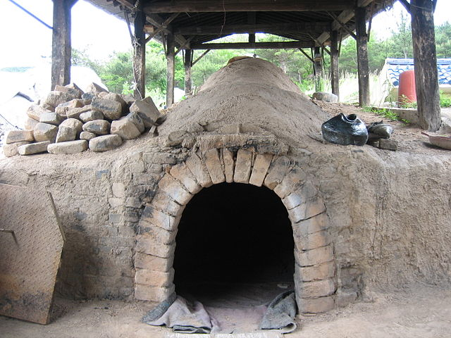
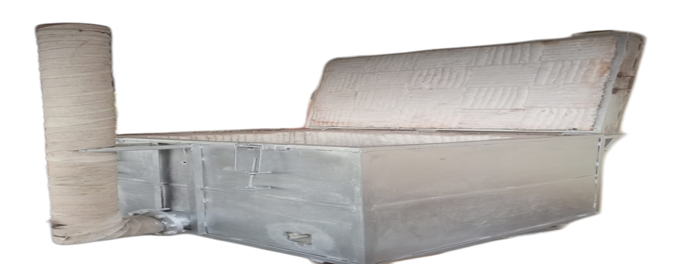
Background
Klin plays a very important role in the pottery manufacturing process
But the traditional Kilns are having following issues:
Less Efficiency
High Energy Consumption
Negative Environmental Impact
Issues in Quality Control and Consistency, etc.

Slide 3
Objective of proposal
Dissemination and demonstration of Technology.
To reduce the drudgery of Rural Potters during loading, Unloading & firing of the Traditional kilns, from hot environment around the kiln & Air pollution problems during wood / dung / straw firing.
To enable higher temperature inside the kiln of around 850°C & to achieve temperature uniformity inside the kiln for production of Stoneware terracotta resulting lower rejections in Comparison to their Existing traditional kilns. Also to increase cleanliness around the kiln.
To keep intact the inherent feelings of Potters and love towards Traditional kilns. And to increase cleanliness around the kiln.
Finally, the increase of living's standard.

Slide 4
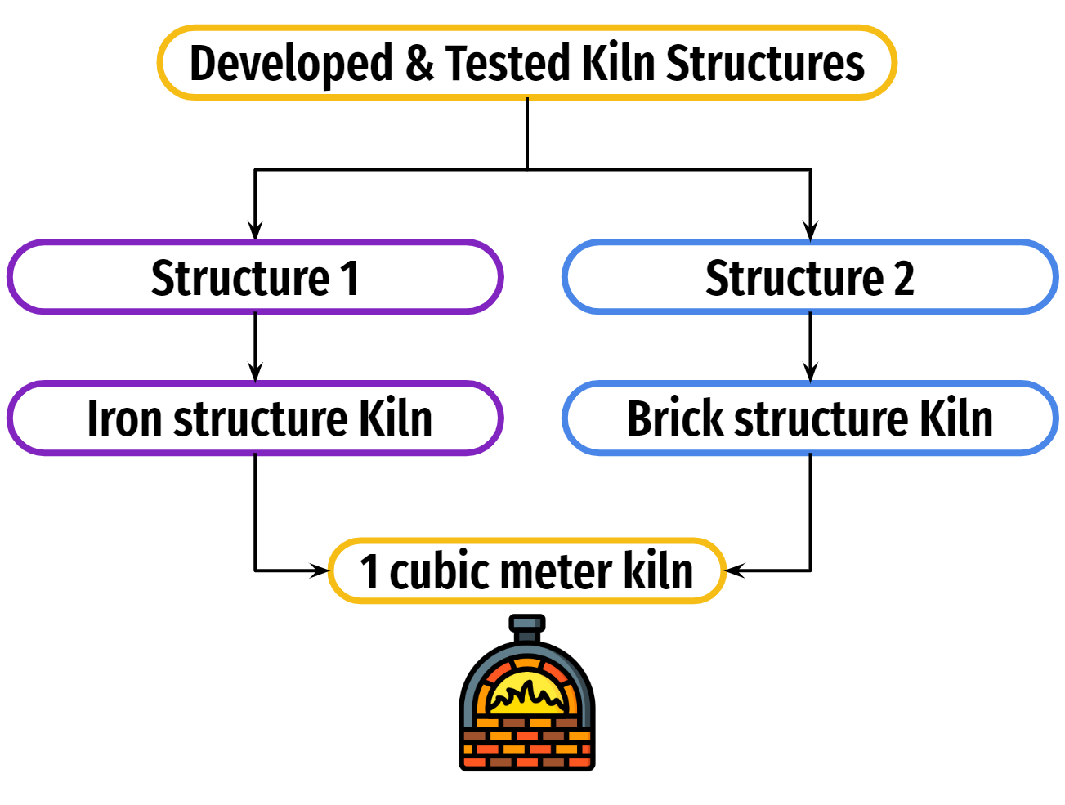
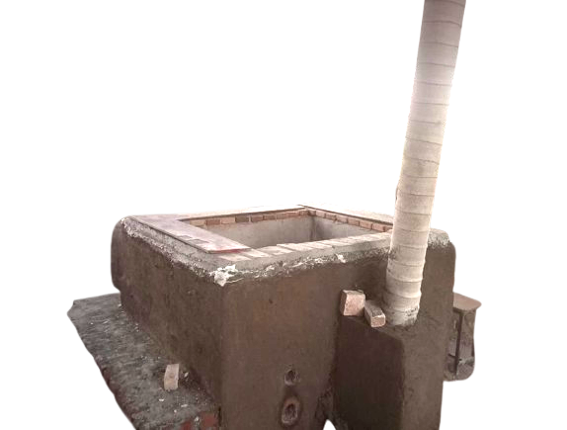
New Technology Kiln
With the help of S&T, We have designed, developed & tested 2 different Kilns using new technology

Slide 5
New Kiln’s Features
Cost-effectiveness:
Kiln construction materials readily available at the district level.
Adoption of construction technology feasible for potters.
Ease of Use:
Simple and appropriate loading and operation of kiln by any family member.
Very low rejection rates due to user-friendly design.
Minimal Fuel Consumption:
Consumption of 8 to 10 kg of fuel for firing products.
Enhanced Thermal Efficiency:
Improvement in thermal efficiency from 8% to 19%.

Slide 6


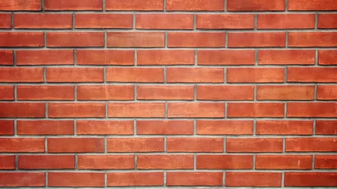
Brick
Kiln Structure
Thermal Epoxy
5” thick Ceramic blanket
9” thick Red clay bricks

Slide 7
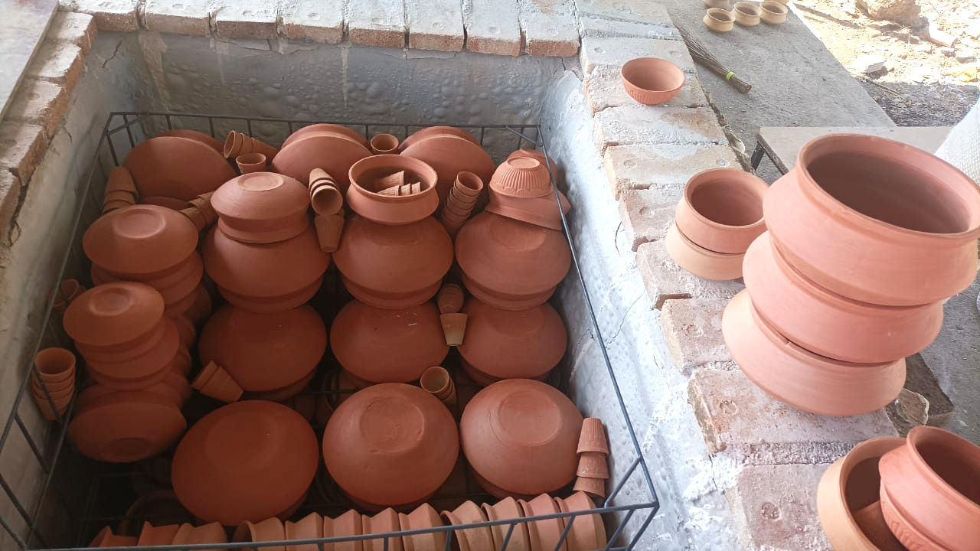
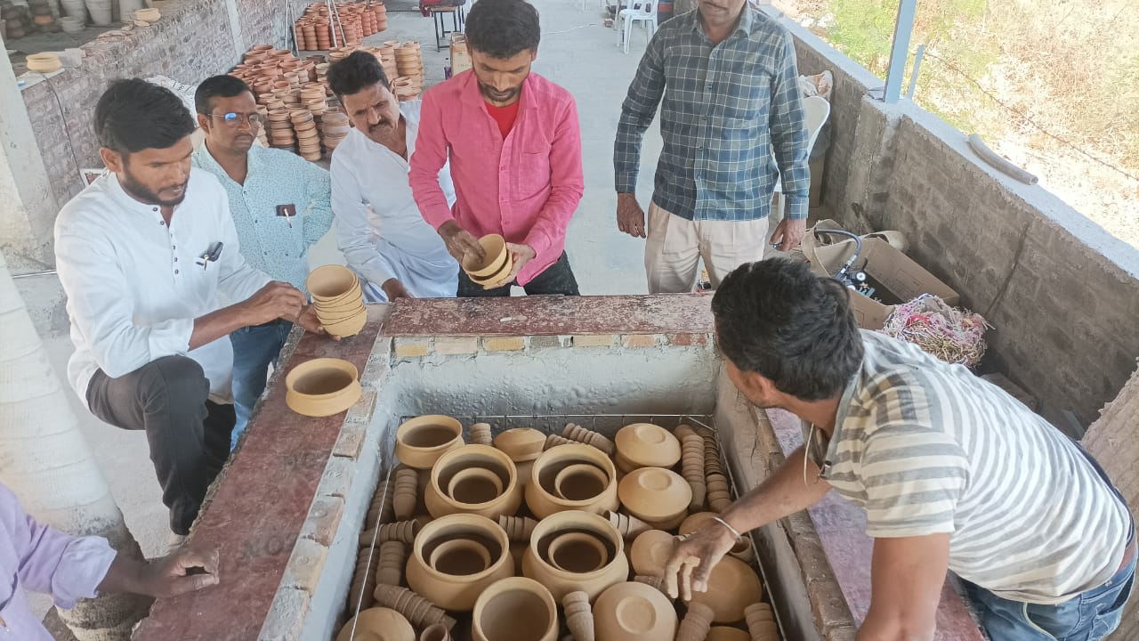
Kiln Appearance

Slide 8



Technology Dissemination Outcomes
Increase in Rural Potter Earnings:
Potter's earnings increase by 20% because fewer pieces are rejected, and the quality of the pottery improves.
Boost in Demand:
Better quality and reproducibility drive increased demand.
Environmentally Friendly Firing:
Traditional furnaces banned in metropolitan areas, prompting closure of units.
Urgent need for eco-friendly kilns to comply with regulations.
Reduction of Human Drudgery:
Operational activities during kiln firing made less labor-intensive.
Easy Construction and Technology Mobilization:
Potters capable of constructing kilns after one demonstration.
Technology easily mobilized for widespread adoption.

Slide 9

Technology Dissemination Location at KVIC units
Locations planned for Kiln Dissemination:
Dharavi Mumbai.
Varanasi UP.
Telangana.
Project Timeline:
Monthwise | Activity
1st | Survey of three selected Rural Pottery cluster in India Mumbai (Dharavi), Varanasi (UP). Hyderabad Telangana
2nd to 4th | Arrangement of Materials for Kiln Constructional in respective clusters.
5th to 9th | Construction & Demonstration of kiln in respective three clusters in each month.
10th to 11th | Follow up & checkup of the problems if any and final demonstration of technology.
12th | Preparation and submission of completion of Project Report.

Slide 10
Thank You

